Slide 1
Bootstrapping Multi-view Learning for Test-time Noisy Correspondence
Changhao He, Di Xue, Shuxian Li, Yanji Hao, Xi Peng, Peng Hu#
Sichuan University，AVIC Chengdu Aircraft Design & Research Institute
CVPR 2026
Notes:
大家好，我是来自四川大学的何长浩。非常荣幸受邀来到这里，和大家分享我们在 CVPR 2026 上的一项研究工作。我们的论文题目是《Bootstrapping Multi-view Learning for Test-time Noisy Correspondence》关注的是多视图学习在真实部署中一个常见但又容易被忽略的问题，就是测试时跨视图错配。

Slide 2
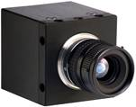
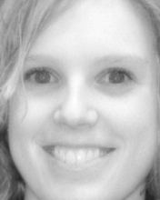
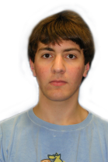
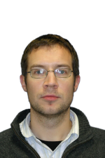

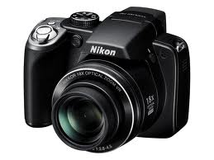
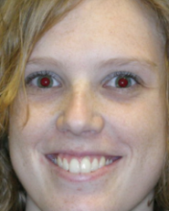
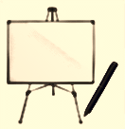
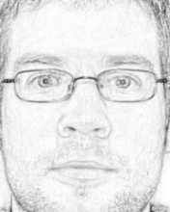

Background
Data may consist of multiple modalities or views
View 1
…
View 2
…
View 3
A young man in a yellow short shirt is sitting and playing the guitar on the beach.
Image
Text
Notes:
多视图或多模态数据在现实中非常常见，比如图像和文本、视频和音频、RGB 和深度。不同视图往往提供互补信息。

Slide 3
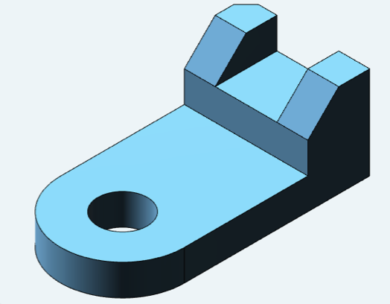
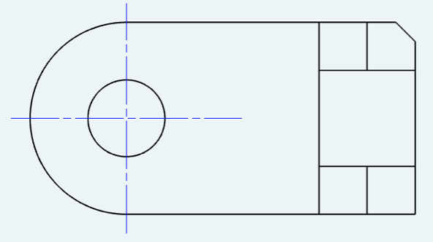
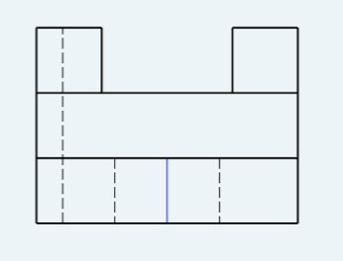
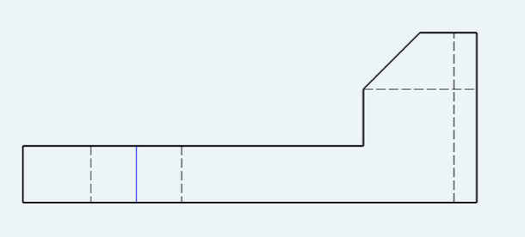
Background
Single-view/modal methods cannot utilize the information from multiple views/modals
Examples:
With all three-view drawing, the objects can be completely modeled
By combining video and audio, we can understand what they are talking about
Thus it is highly expected to develop the multi-view/modals analysis methods!
Notes:
如果只用单视图方法，就无法充分利用这种互补性。多视图学习的目标，就是把不同来源的信息结合起来，得到更完整、更可靠的语义理解。

Slide 4
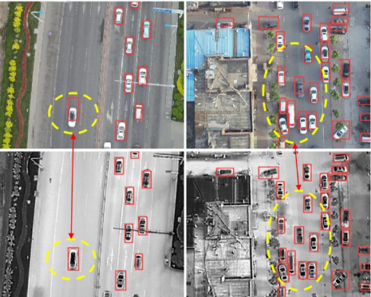
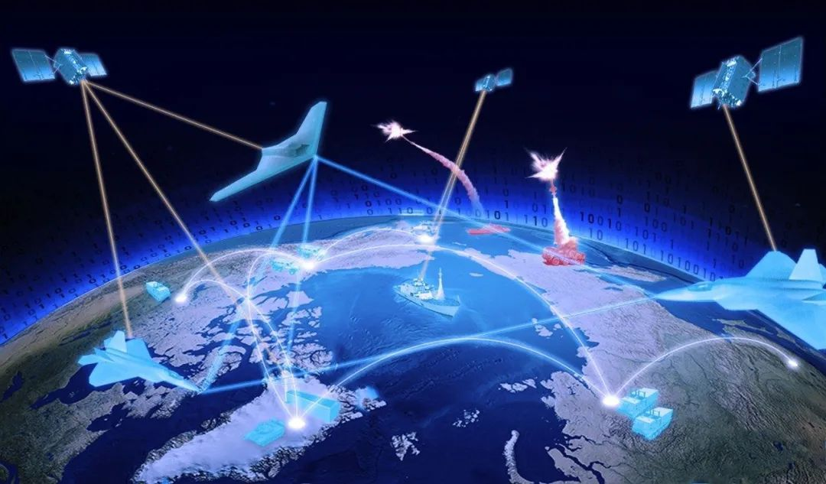

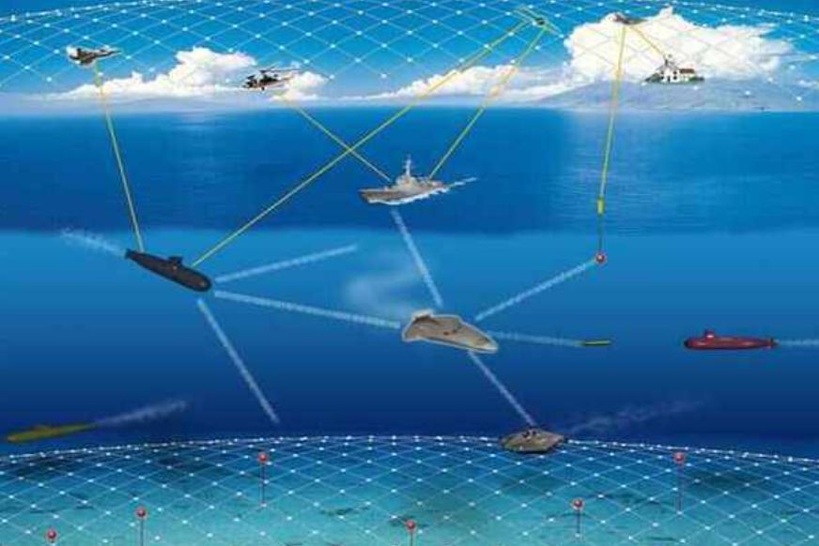
Observation
Open World: Viewpoint shifts and sensor delays lead to inevitable misalignment.
Global Shift
Varying Viewpoints
RGB
Infrared
Relative Shift
Sensor Asynchrony
RGB
Infrared
Notes:
但在真实场景中，多视图并不总是严格对齐的。视角变化、传感器异步、网络延迟等因素都会导致测试时的错配

Slide 5
Observation
Open World: Viewpoint shifts and sensor delays lead to inevitable misalignment.
Global Shift
Varying Viewpoints
RGB
Infrared
Test-time Noisy Correspondence
Relative Shift
Sensor Asynchrony
RGB
Infrared
Notes:
也就是我们定义的 Test-time Noisy Correspondence，简称 TNC。

Slide 6

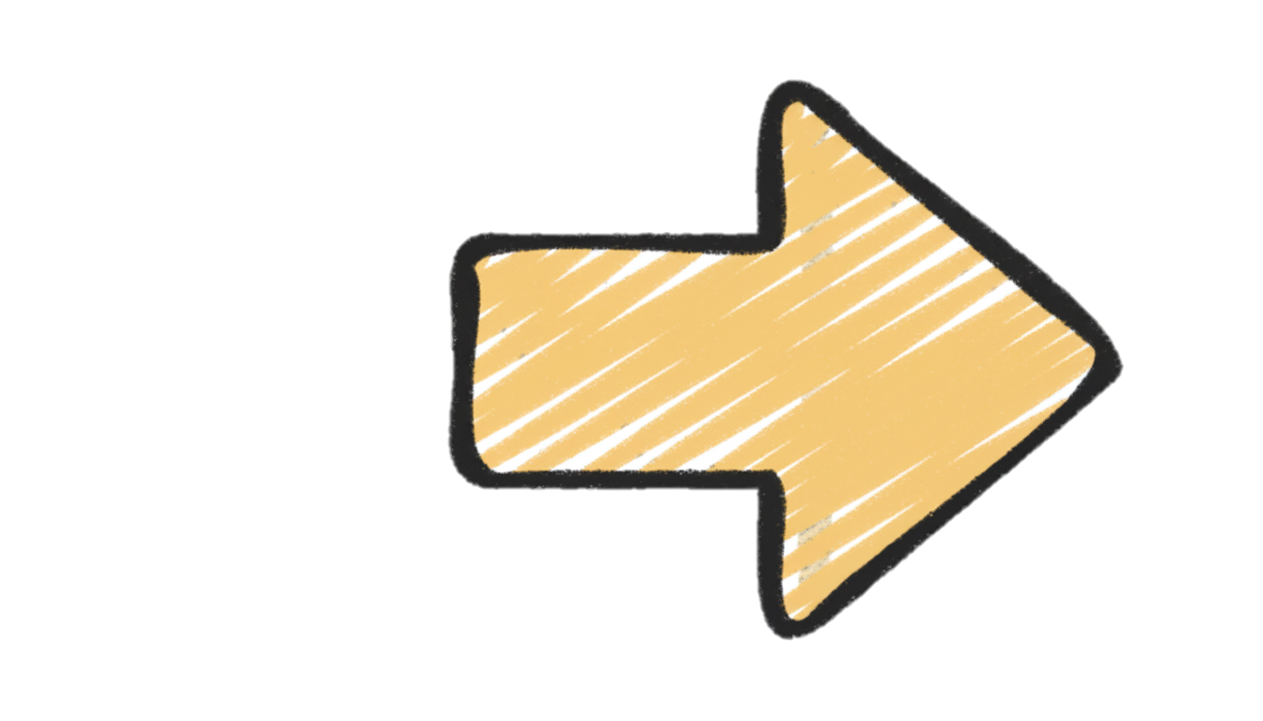

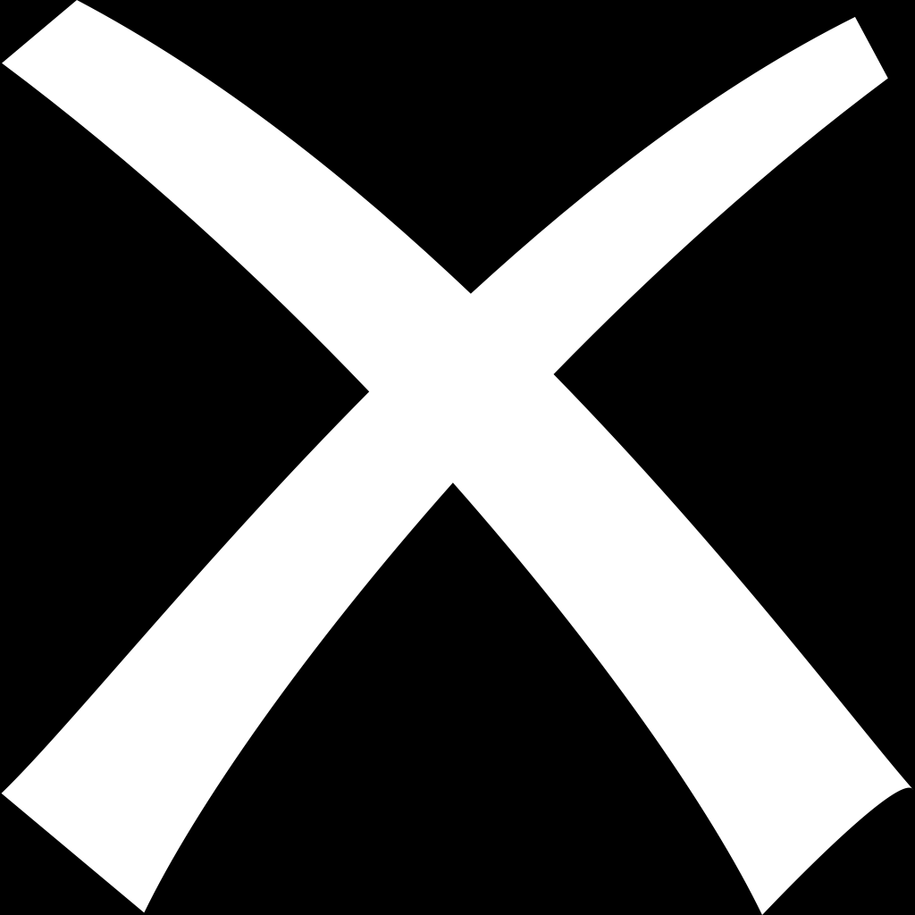

Observation & Key idea
Existing works
Train set
EDL
task constraints
Test set (TNC)
or
reliability estimator
FST
task constraints
Task Gap
Blind Estimation: Reliability is learned exclusively from clean, well-aligned training data.
The Consequence: A severe Train-Test Task Gap. Models cannot extrapolate to handle unseen misalignments at deployment.
Notes:
现有很多方法会估计每个视图的可靠性，比如基于 EDL 或 FST 的方法，但它们大多只在干净、对齐的训练集上学习权重。这样一来，训练时学到的可靠性估计器要直接外推到带错配的测试场景，就会出现明显的 train-test task gap。

Slide 7


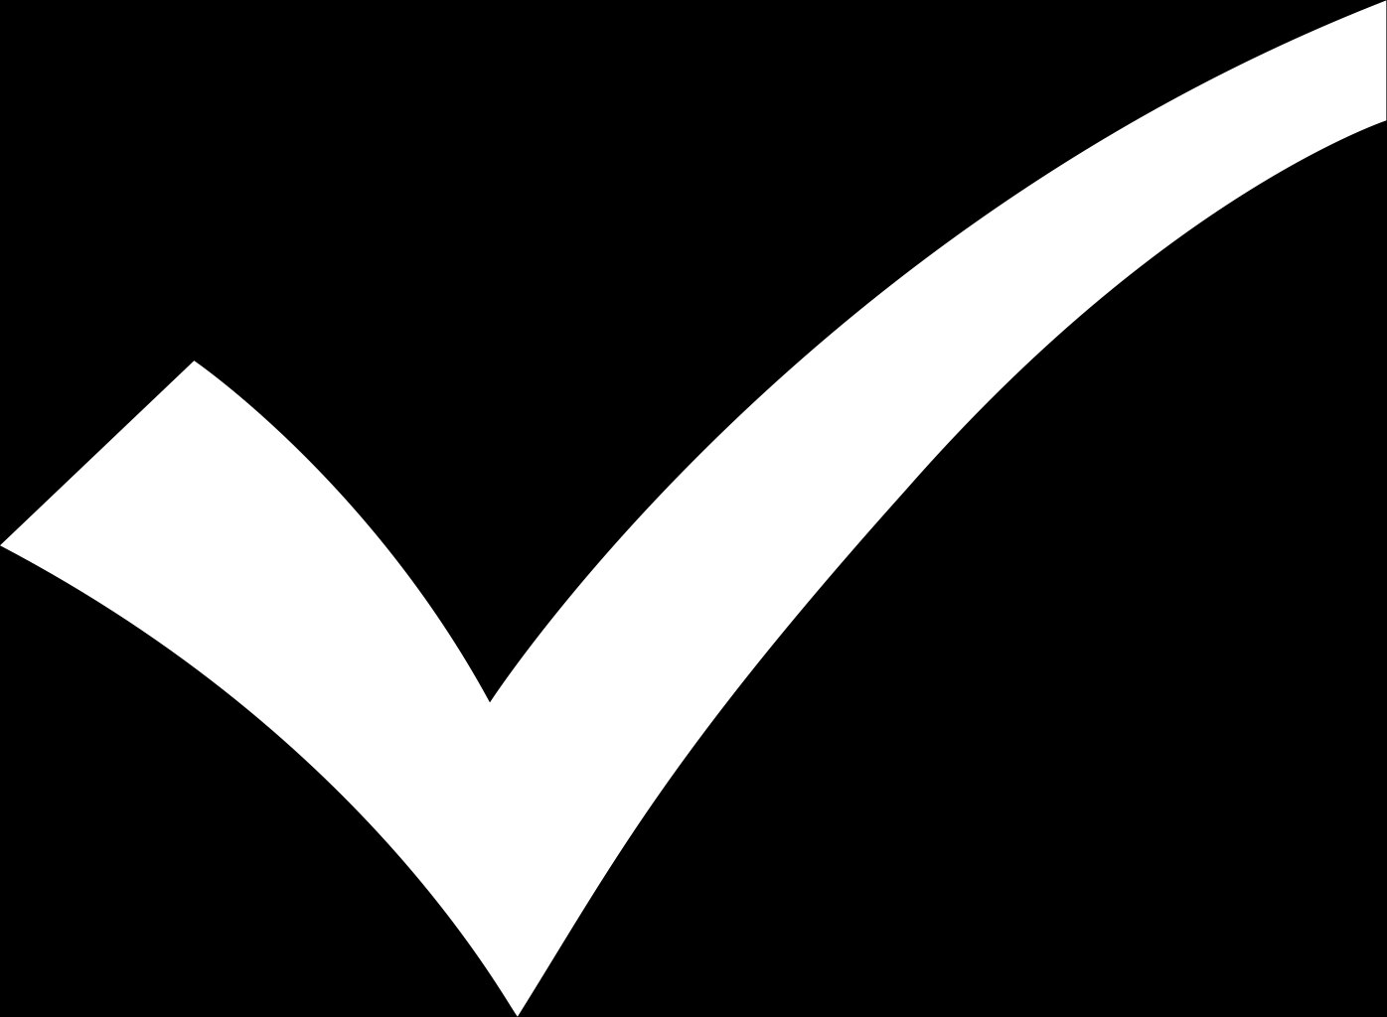
Observation & Key idea
Our motivation
Train set
Bootstrapped set
in-place TNC bootstrapping
task constraints
High reliability
Low reliability
1
bootstrapped supervision
0
Task Oriented
reliability estimator
Test set (TNC)
Data Perspective: Simulating test-time misalignments via in-place TNC bootstrapping.
Model Perspective: Adopting a Reveal-Supervised Paradigm to provide explicit, task-oriented guidance for reliability estimator.
Notes:
我们的核心想法就是同时从数据和模型两个角度去弥合这个 gap。数据层面，我们在训练阶段原地构造 TNC 样本；模型层面，我们不再盲目估计可靠性，而是给估计器明确、任务导向的监督。

Slide 8
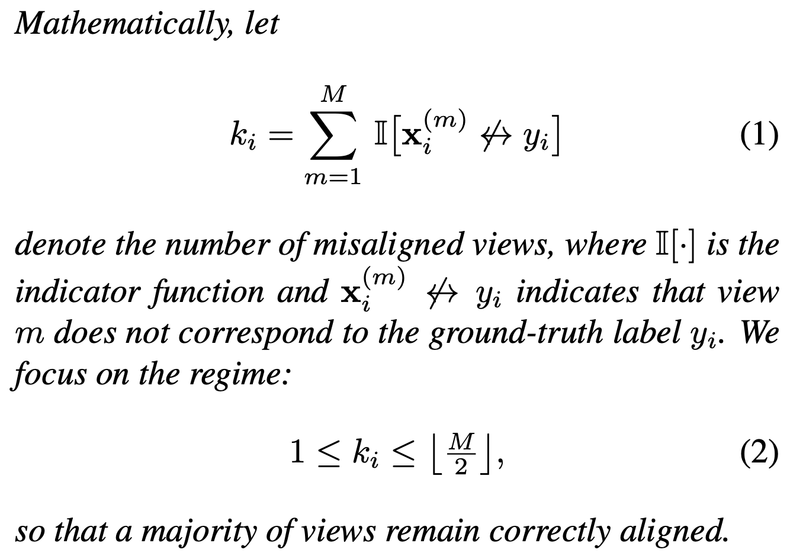
Method
Notes:
我们从干净训练集出发，通过 in-place TNC bootstrapping 构造带噪样本，然后把原始样本和带噪样本交替训练；模型内部再利用多个信号去估计 view reliability，最后做加权融合。

Slide 9
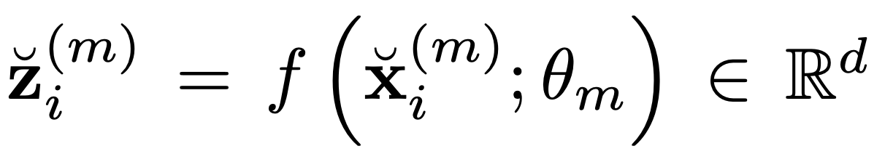
Method
Signal 1: View-specific Feature
Notes:
第一个信号是 view-specific feature，也就是每个视图自己的表征特征。它提供了基本语义信息，但只靠特征本身还不足以判断这个视图是不是发生了错配。

Slide 10
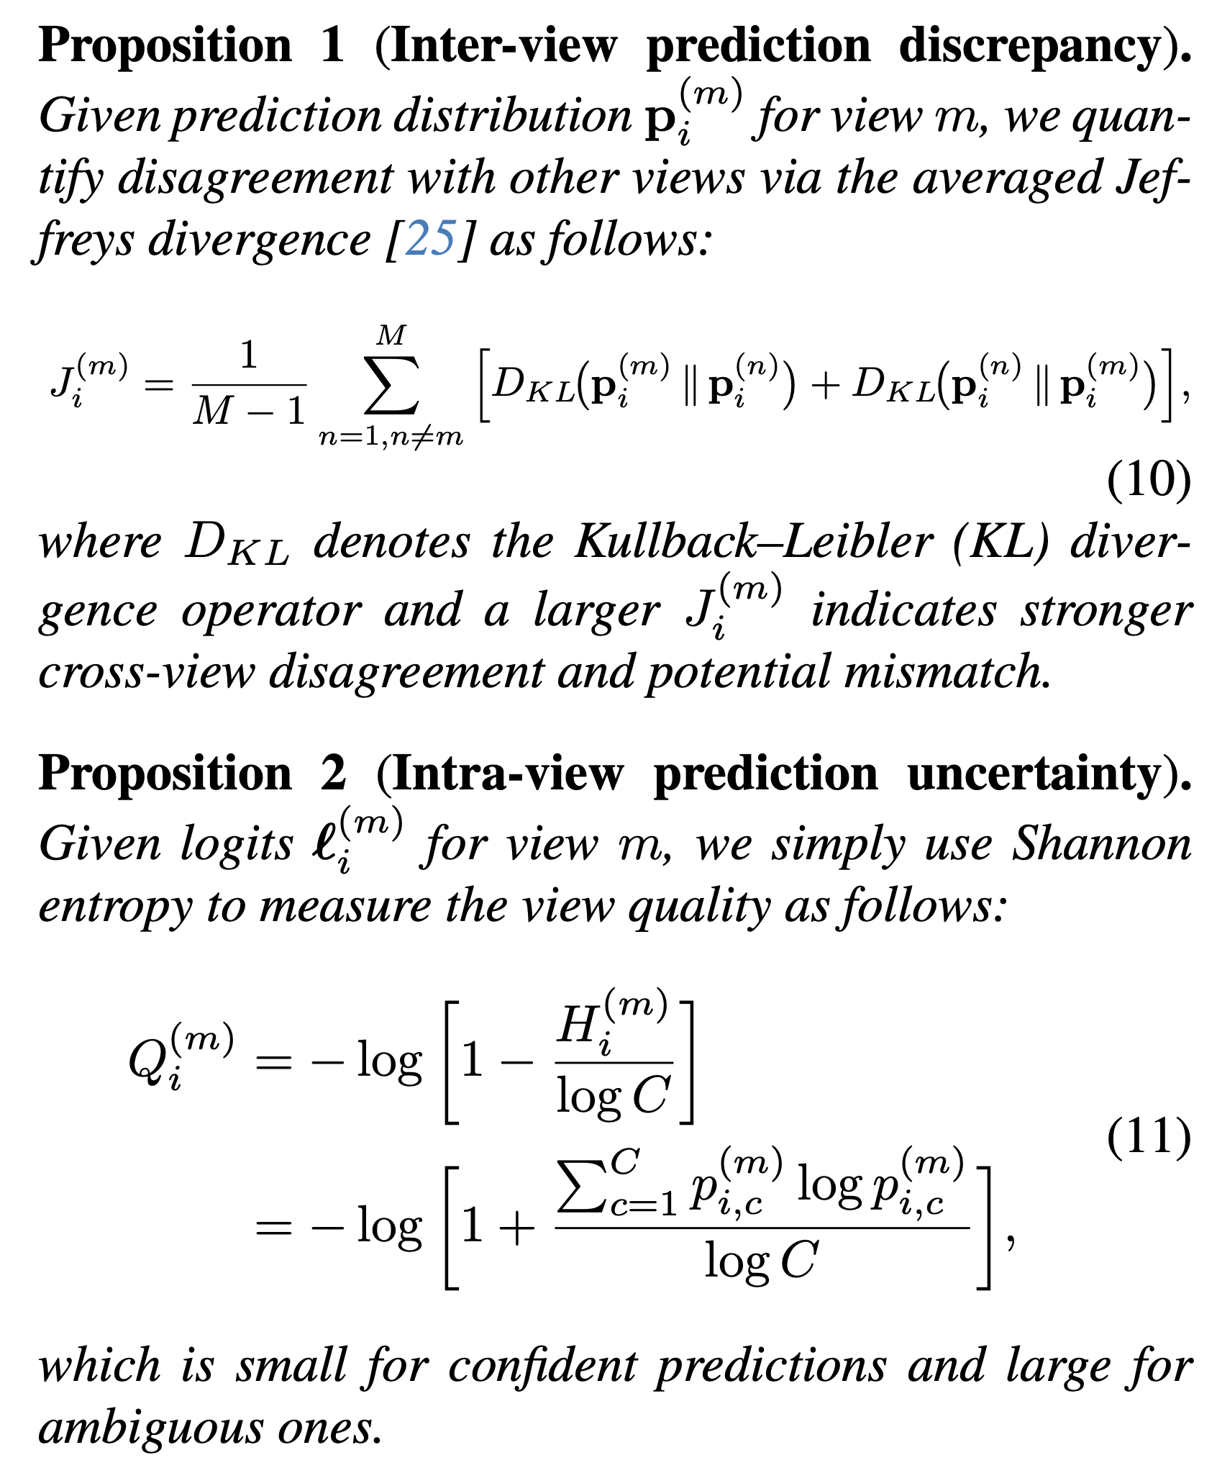
Method
Signal 1: View-specific Feature
Signal 2: Intra-view prediction uncertainty
Notes:
所以我们加入第二个信号，也就是 intra-view prediction uncertainty。直观来说，如果一个视图本身质量差或者语义不清，它的预测熵会更高，不确定性也就更大。

Slide 11
Method
Signal 3: Inter-view prediction discrepancy
Notes:
第三个信号是 inter-view prediction discrepancy。我们用跨视图预测分布之间的差异来衡量一致性，如果某个视图和其他视图明显不一致，那它更可能是错配视图。

Slide 12
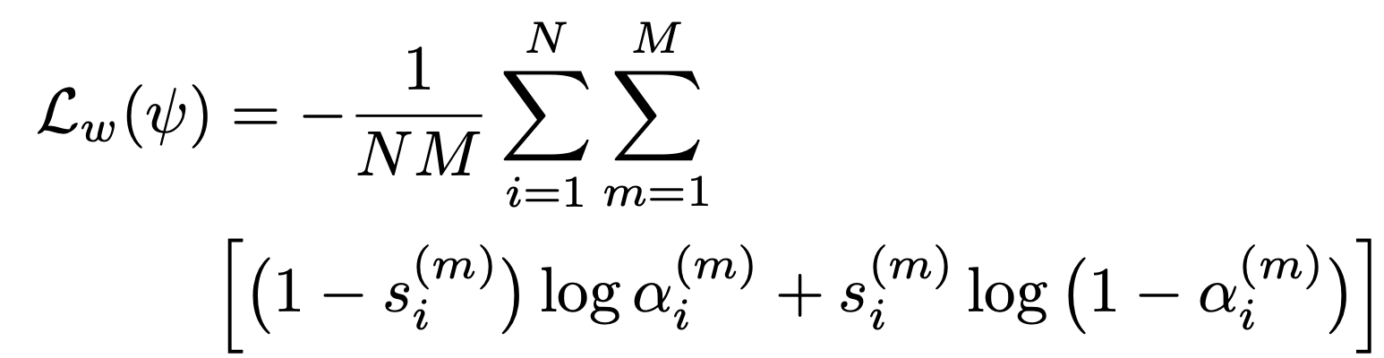
Method
Signal 3: Inter-view prediction discrepancy
Bootstrapped Supervision Loss
Notes:
有了这三个信号之后，我们还引入了 bootstrapped supervision loss。因为训练时哪些视图是我们故意打乱的，其实是已知的，所以可以直接监督可靠性估计器学会“干净视图给高权重，错配视图给低权重”。

Slide 13
Method
Bootstrapped Supervision Loss
Notes:
这一点和已有工作最大的区别在于，我们把 reliability estimation 从 blind estimation 变成了 reveal-supervised learning。也就是说，可靠性不是间接猜出来的，而是被显式教出来的。

Slide 14
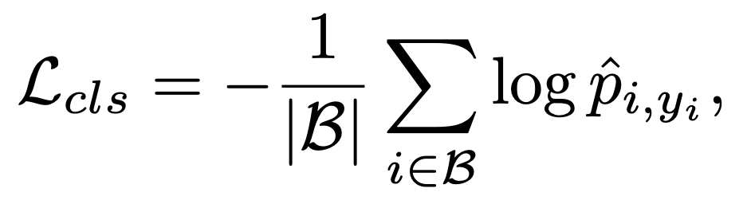
Method
Bootstrapped Supervision Loss
Task Loss
Notes:
当然，可靠性学习不能脱离最终任务，所以我们还保留 task loss。这样模型不会只盯着“找噪声”，而是会学习怎样在分类目标下更好地融合多个视图。

Slide 15
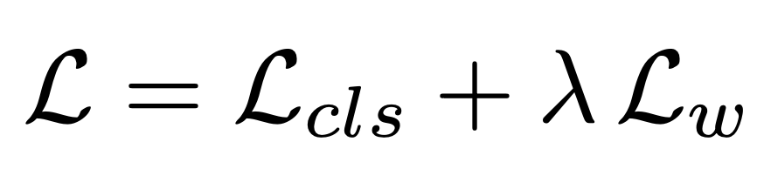
Method
Bootstrapped Supervision Loss
Task Loss
Overall Loss
Notes:
最终整体损失就是 task loss 和 bootstrapped supervision loss 的联合优化。通过这个联合目标，模型既能识别错配，又能把这种识别真正转化为更鲁棒的融合结果。

Slide 16
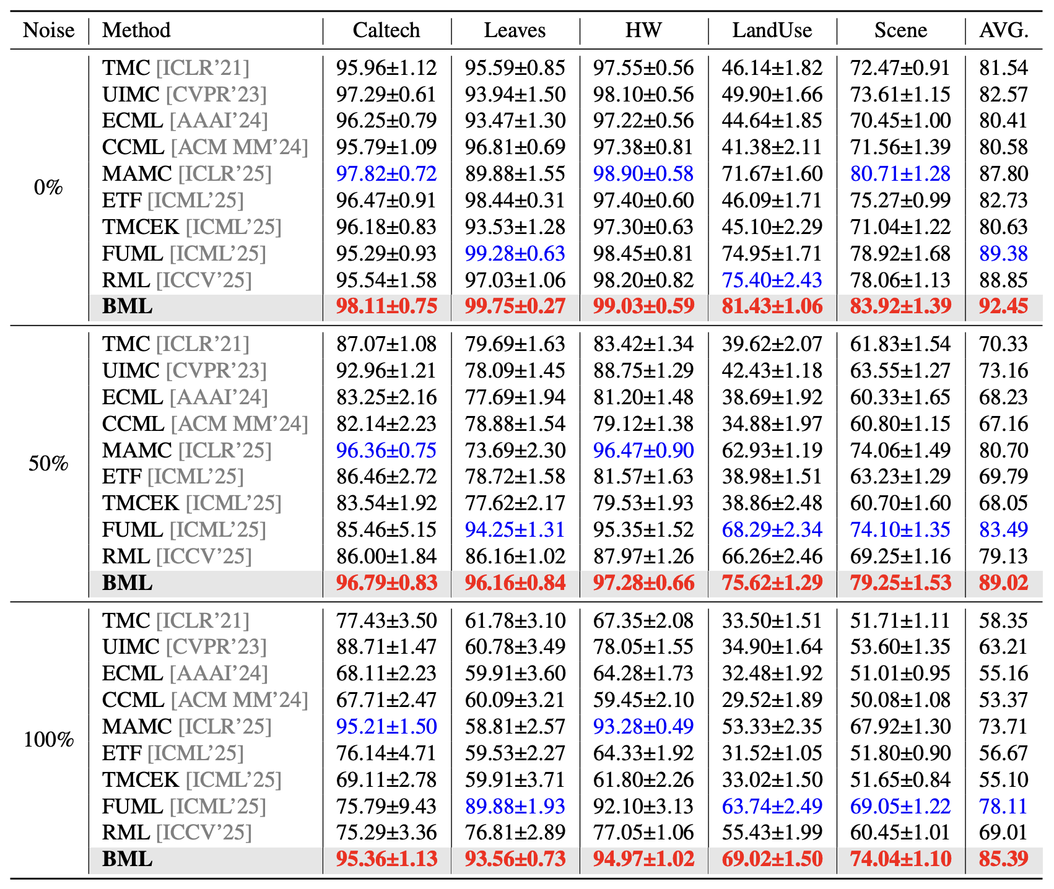
Experiment
Classification Performance under Test-time Noisy Correspondence
3.07
Consistent robustness across noise ratios！
5.53
7.28
Notes:
这里是第一组分类实验结果。在 0%、50%、100% 三种测试噪声比例下，我们相对最强基线平均分别提升了 3.07、5.53 和 7.28 个百分点，说明噪声越强，BML 的优势越明显。

Slide 17
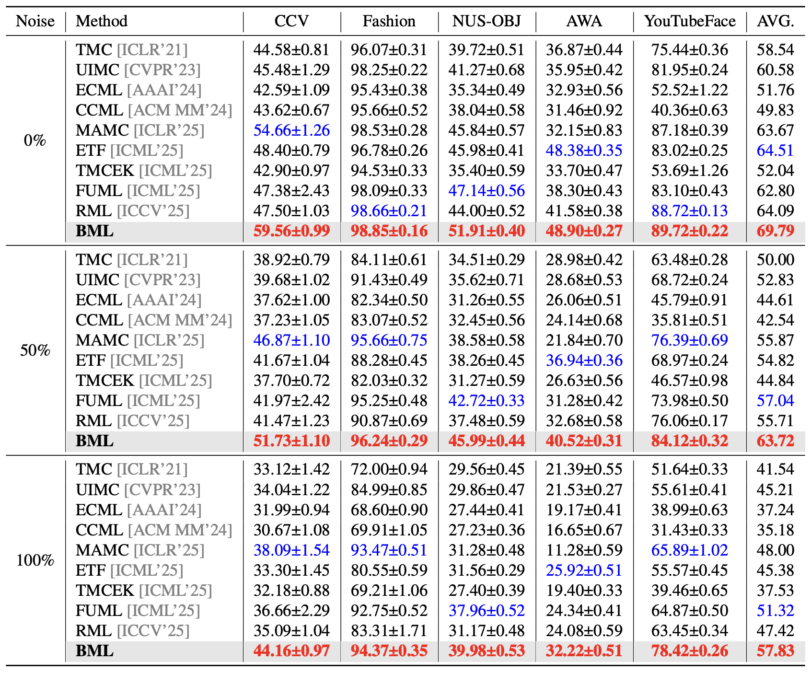
Experiment
Classification Performance under Test-time Noisy Correspondence
5.28
Consistent robustness across noise ratios！
6.68
6.51
Notes:
第二组更大规模数据集上也有同样趋势，也就是说，BML 不仅在小规模数据上有效，在更复杂、更大规模场景下同样稳定。

Slide 18
Experiment
Classification Performance under varying noise levels
Performance advantage becomes more pronounced as TNC noise increases
Notes:
这一页展示的是 0% 到 100% 连续噪声水平下的表现曲线。可以看到随着 TNC 噪声增强，很多基线会明显下滑，而 BML 的下降更慢，所以相对优势会逐渐拉大。

Slide 19
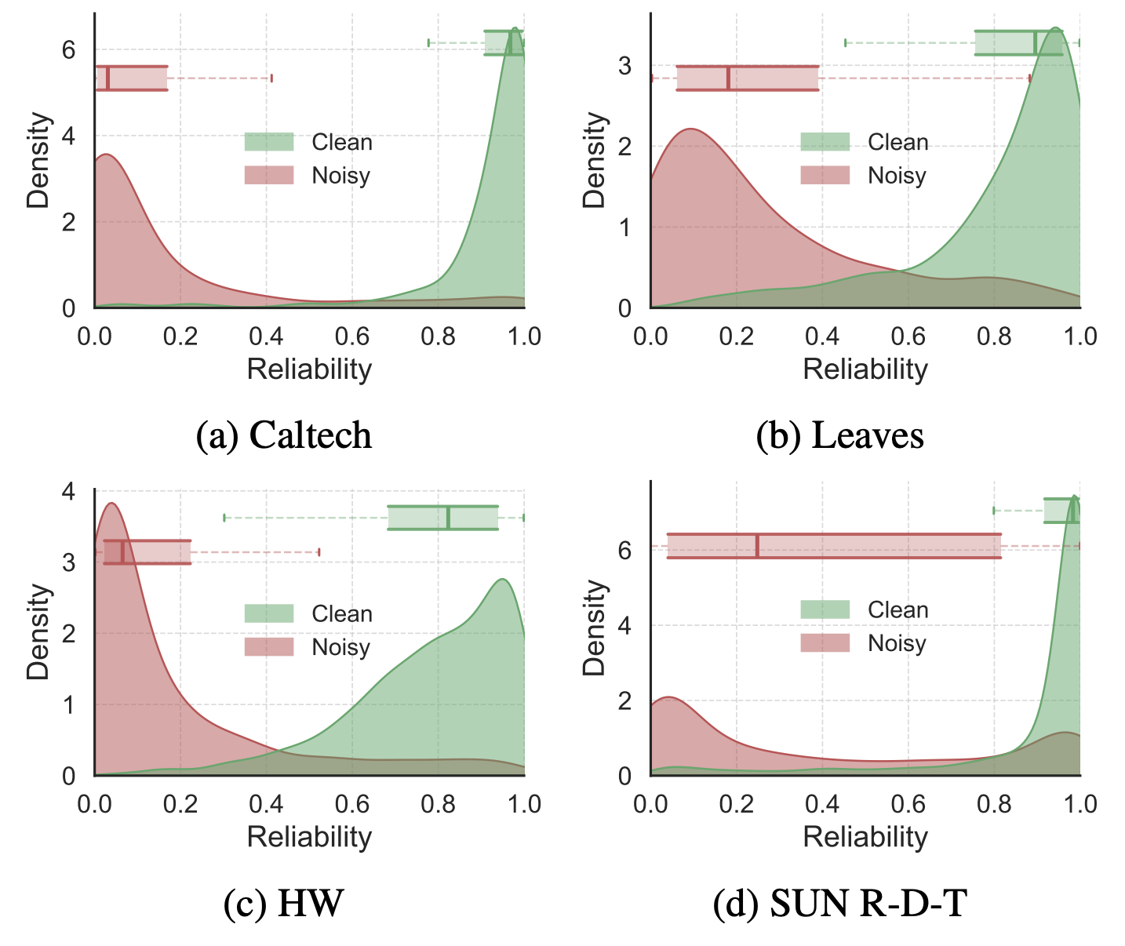
Experiment
Density plots and box plots of the estimated view reliability
Clean views: Accurately assigned high reliability (~1.0)
Noisy views: Effectively suppressed with low reliability (~0.0).
Notes:
这张图从可靠性分布的角度解释了为什么 BML 有效。干净视图的可靠性主要集中在 1 附近，而噪声视图集中在 0 附近，说明估计器确实学会了区分对齐视图和错配视图。

Slide 20
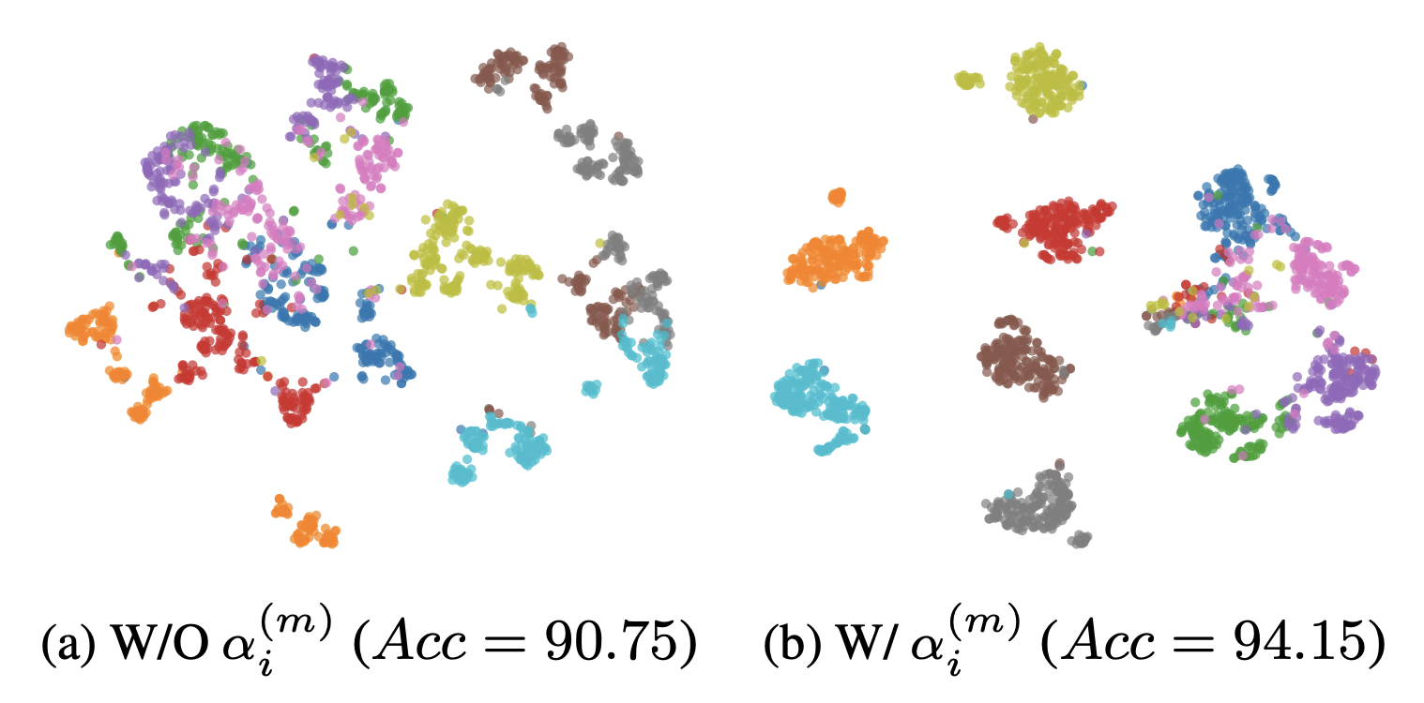
Experiment
t-SNE visualization comparison W/ & W/O view reliability
Enhanced Discriminability
Reliability weighting effectively clusters aligned views and separates misaligned ones.
Notes:
这里是 t-SNE 可视化。加入 reliability weighting 之后，不同类别的聚类更紧、更分离，说明可靠性估计不仅抑制了噪声，也提升了最终表示的可分性。

Slide 21
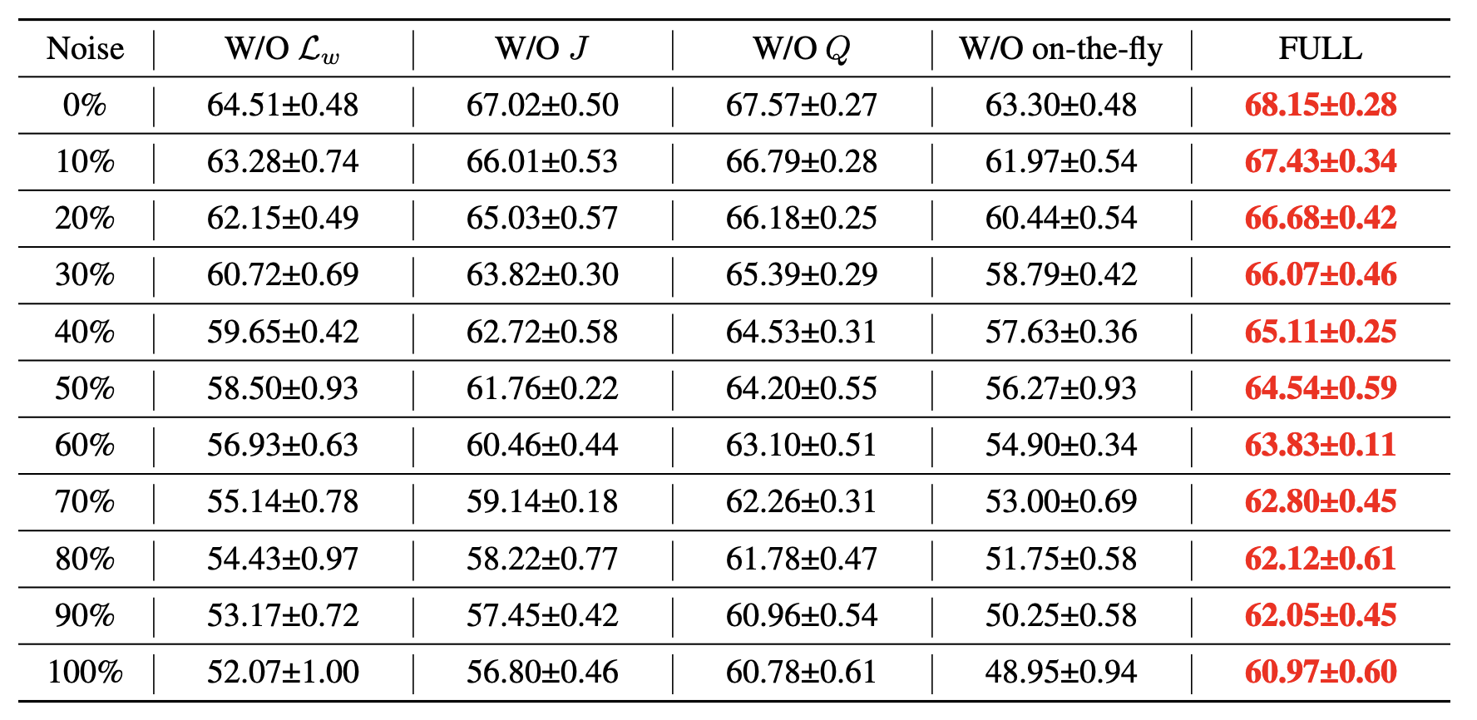
Experiment
Ablation results at various noise ratios
Dynamic resampling and discrepancy modeling are the core drivers of BML's robustness.
Notes:
消融实验说明两个模块尤其关键。第一是动态重采样的 bootstrapping，如果噪声模式固定，模型会过拟合；第二是 inter-view discrepancy，它比单纯的不确定性更能抓住 TNC 的本质。

Slide 22
Experiment
Parameter Analysis of the loss coefficient and noise-augmented proportion
strong stability across a wide range of hyperparameters
Notes:
参数分析表明，BML 对超参数整体比较稳定。损失权重太小学不到足够的 TNC 监督，太大又会影响分类目标；噪声增强比例方面，ρ=0.5 在大多数数据集上是比较稳健的选择。

Slide 23
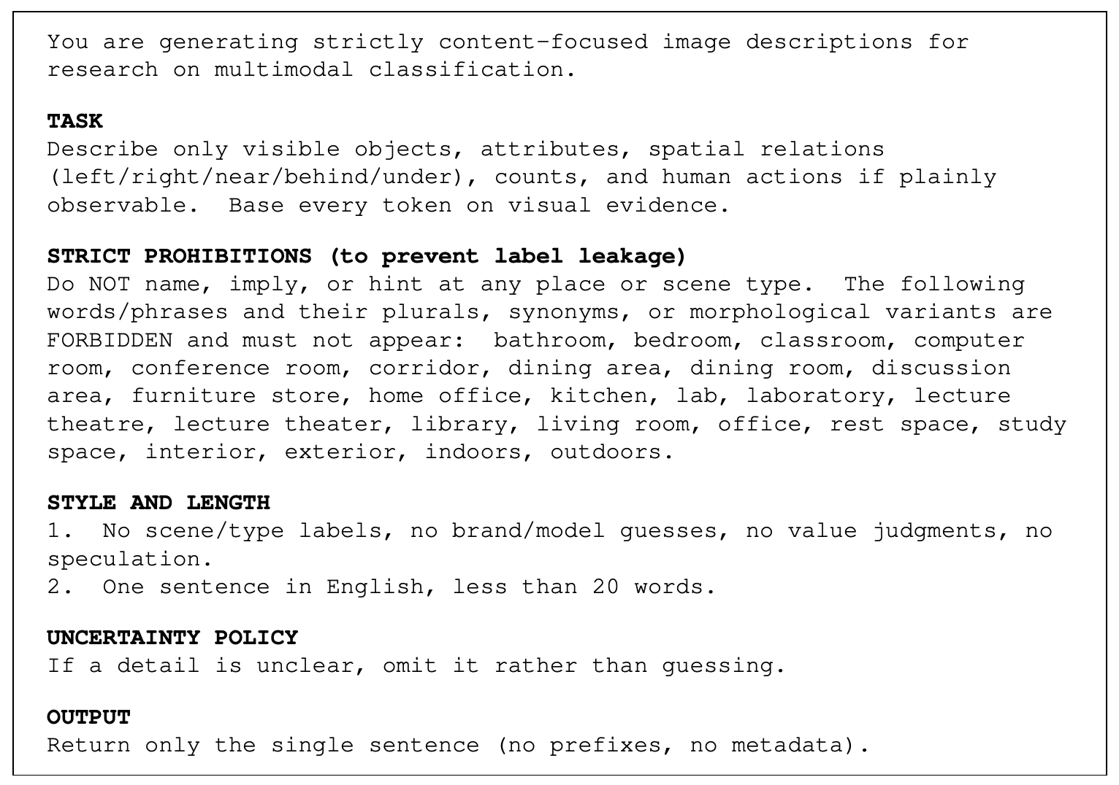
Experiment
SUN R-D-T Benchmark: Structured Prompt for Text Generation
Notes:
除了常见特征型数据集，我们还构建了一个新的 SUN R-D-T benchmark，把 RGB、Depth 和 Text 三种视图结合起来。这里展示的是生成文本视图时使用的 structured prompt，重点是只描述可见内容，并严格禁止场景词，避免标签泄漏。

Slide 24
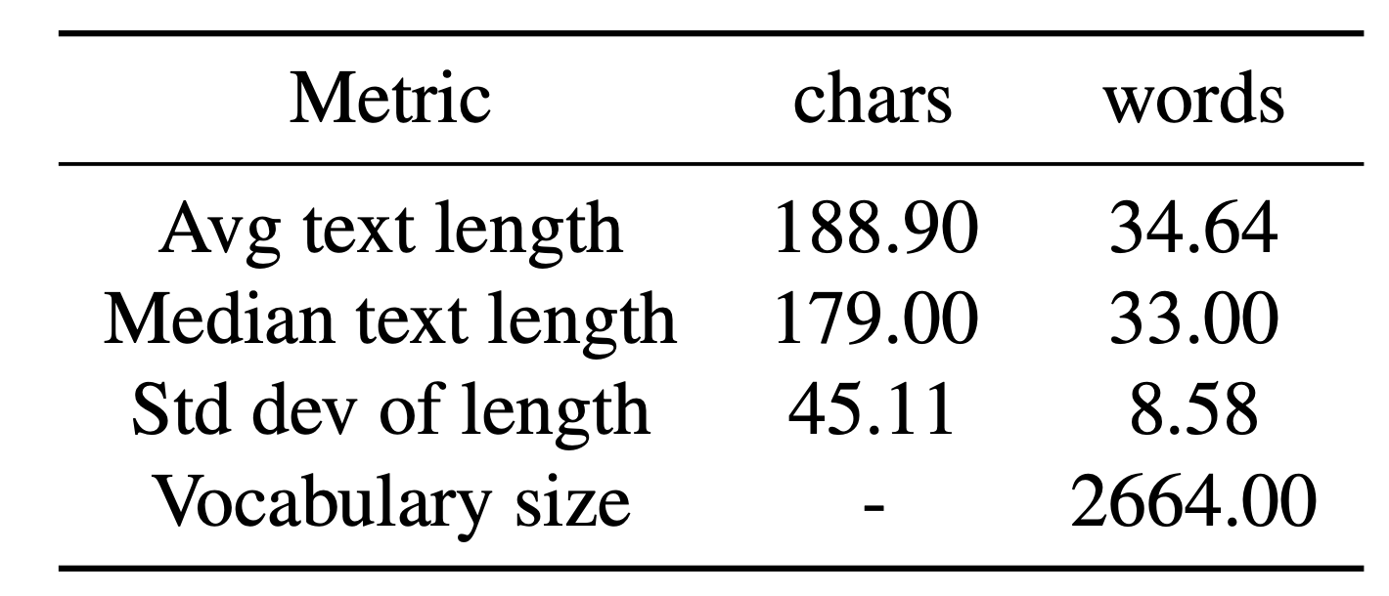
Experiment
Word Cloud Visualization
High-frequency terms are strictly spatial relations (e.g., left, right, behind) and object nouns.
Length Statistics & Vocabulary
Contains 2,664 unique words despite concise caption lengths.
Notes:
从统计结果看，这些文本描述虽然比较简洁，但词汇覆盖并不低，一共有 2664 个 unique words。高频词主要是空间关系和物体名词，说明文本视图确实捕捉到了场景中的结构性信息。

Slide 25
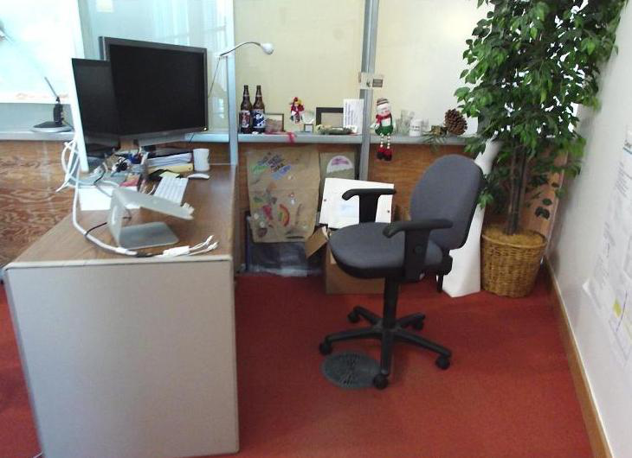
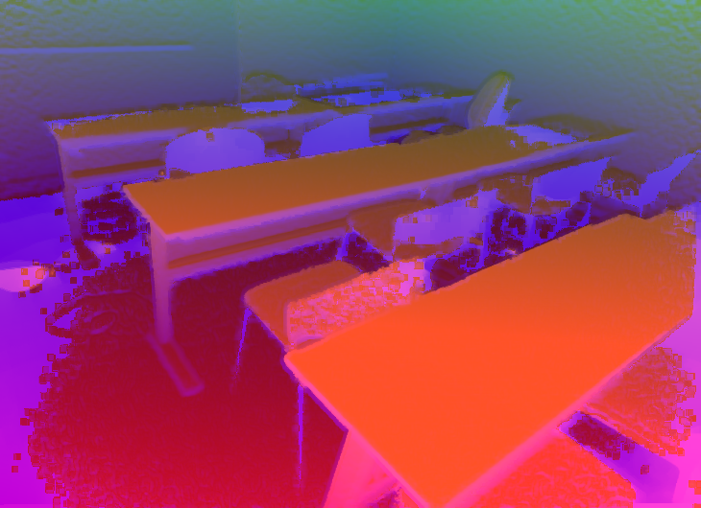
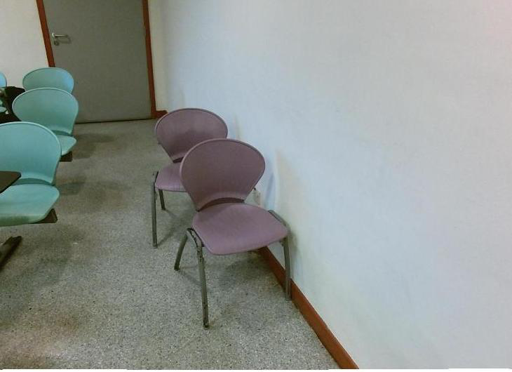
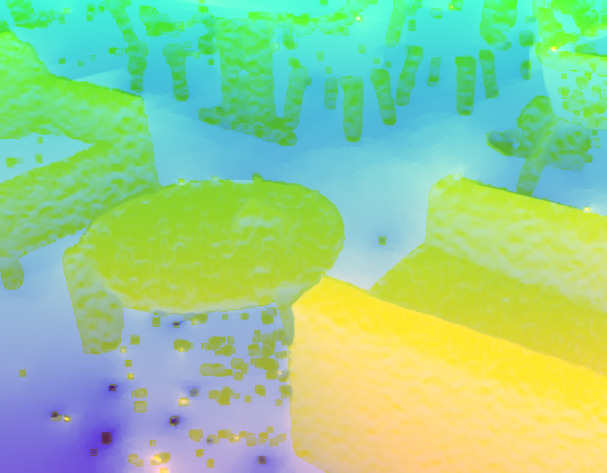
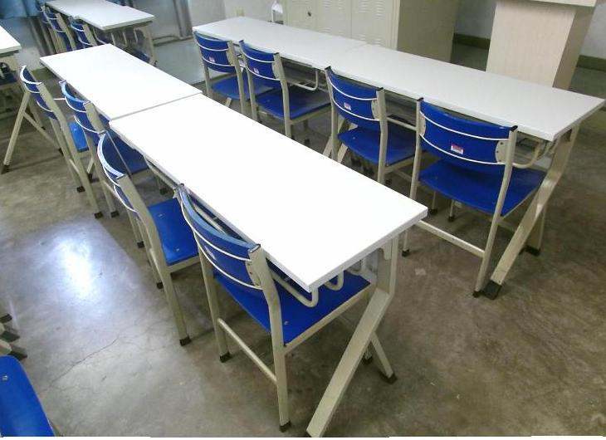
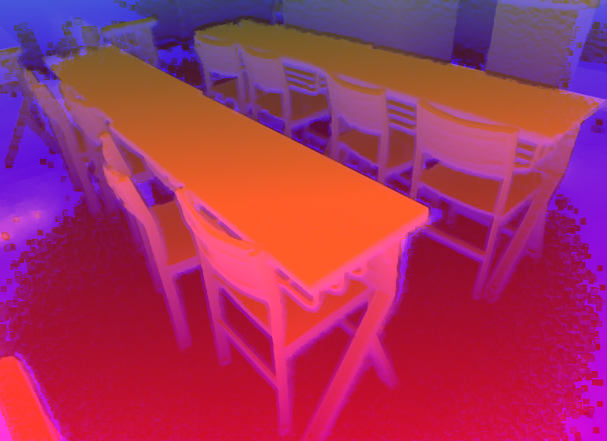
Experiment
Qualitative Case Study: Reliability Estimation under TNC (Classroom)
RGB view
Depth view
Text view
Six white rectangular tables with gray legs are arranged in two rows; each table has a maroon seat with black frame; white cables lie on the gray patterned floor; two whiteboards are on the back wall.
0. 0802
0. 9970
0. 9941
Two purple chairs with metal legs are positioned against a white wall with brown baseboard; to the left, three light blue chairs are arranged near a dark table, with a closed door visible in the background.
0. 9962
0. 0397
0. 9911
Three cardboard boxes sit atop a white desk with a light blue drawer unit; a gray swivel chair with a green backrest is positioned in front, and a beige filing cabinet is to the right.
0. 9181
0. 8453
0. 0015
Notes:
这是 Classroom 类别的定性案例。可以看到发生错配的模态会被赋予非常低的可靠性，比如有的视图权重接近 0，而对齐视图通常接近 1，说明模型能在真实样例里准确识别异常来源。

Slide 26
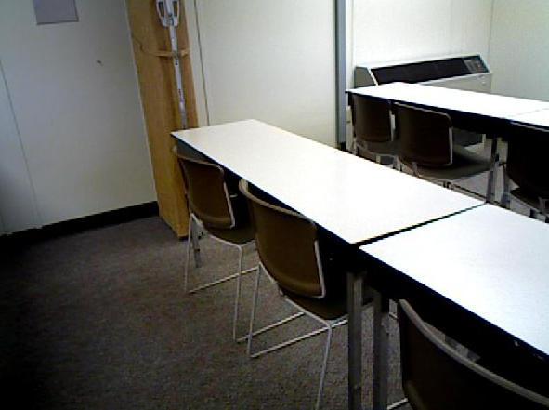
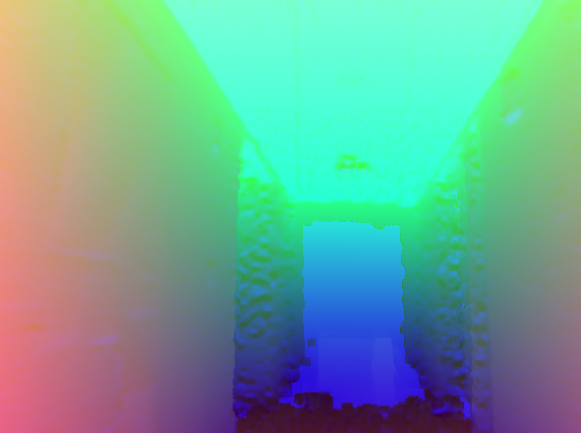
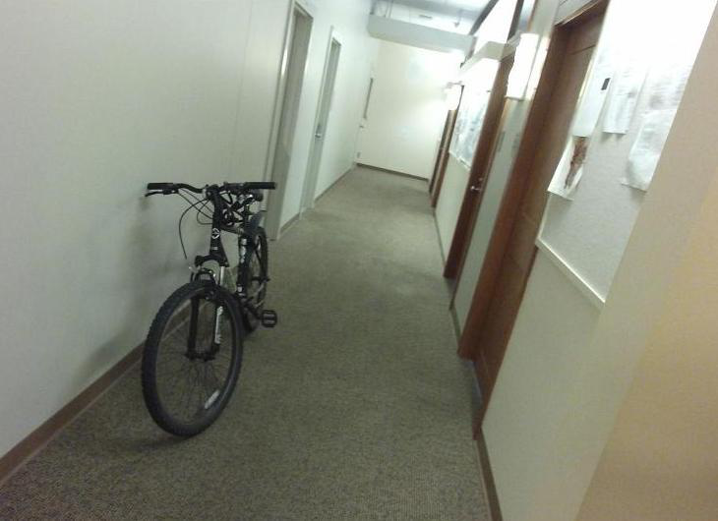
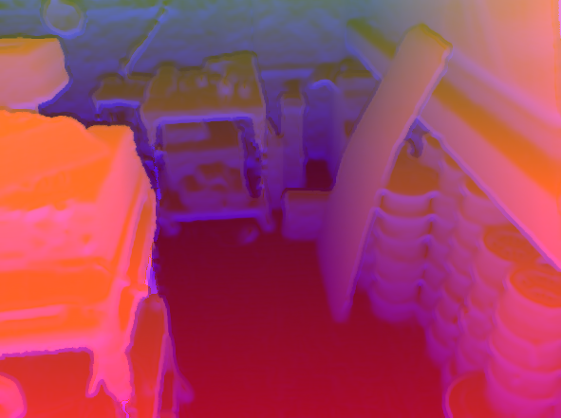
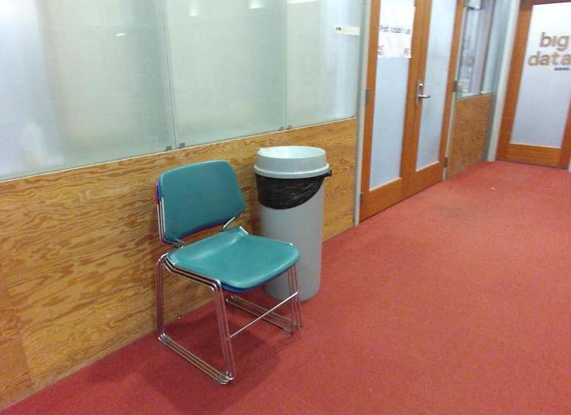
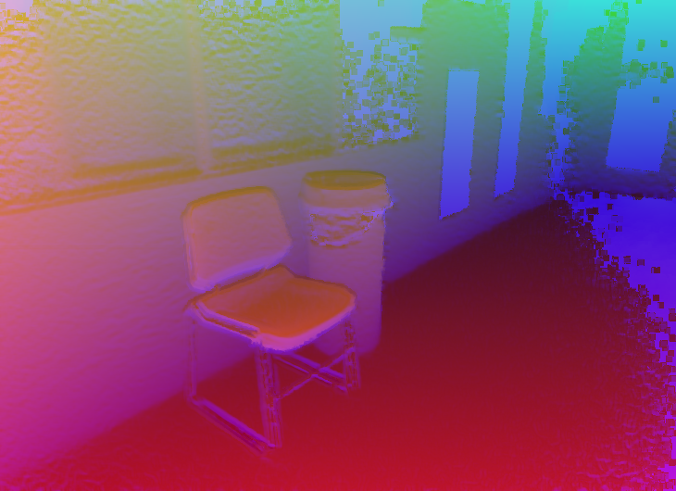
Experiment
Qualitative Case Study: Reliability Estimation under TNC (Corridor)
RGB view
Depth view
Text view
A long hallway with red walls on the left and white walls on the right, lined with papers, signs, and doors; ceiling lights illuminate the shiny floor, and an exit sign is visible ahead.
0. 0033
0. 9873
0. 9606
A black bicycle with front suspension is parked against the left wall in a narrow space with beige carpet, white walls, and multiple closed doors on the right side.
0. 9676
0. 0169
0. 9916
A black mesh office chair sits on blue carpet near a gray filing cabinet, with a desk holding papers, a monitor, and a telephone to the right; shelves with binders and books are mounted on the wall behind.
0. 9687
0. 9919
0. 0116
Notes:
Corridor 的例子也是同样的现象。即使某个模态语义上很像正常样本，只要它和其他视图不一致，BML 仍然会把它压低，从而避免错误融合。

Slide 27

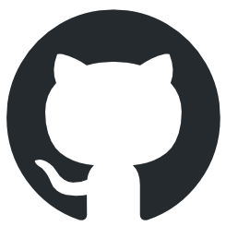

Thanks for
your
attention!
College of Computer Science
Sichuan University
XLearning Lab
Code
XLearning-SCU/2026-CVPR-BML
Dataset
XLearning-SCU/SUN-R-D-T
Notes:
最后总结一下，我们的工作针对的是多视图学习在部署阶段的错配问题，核心贡献是用 bootstrapping 和 reveal-supervised reliability estimation 来缩小 train-test gap。代码和数据集都已经开源，欢迎大家交流指正，谢谢。

